Slide 1

Considering Time in Designing
Large-Scale Systems for Scientific Computing
Nan-Chen Chen¹
Sarah S. Poon²
Lavanya Ramakrishnan²
Cecilia R. Aragon^{1,2}
¹Department of Human Centered Design & Engineering, University of Washington
²Lawrence Berkeley National Laboratory
Notes:
Hi everyone! Thank you for staying at the conference until now. My name is Nan-Chen Chen. I am a third year PhD student from the Department of Human Centered Design & Engineering at the University of Washington. Today, with my collaborators, Sarah Poon and Lavanya Ramakrishnan from Lawrence Berkeley National Lab, as well as my advisor Cecilia Aragon, I am here to present this work: “Considering Time in Designing Large-Scale Systems for Scientific Computing”. This is an ethnographic work on studying users of high-performance computing, or in short, HPC.

Slide 2
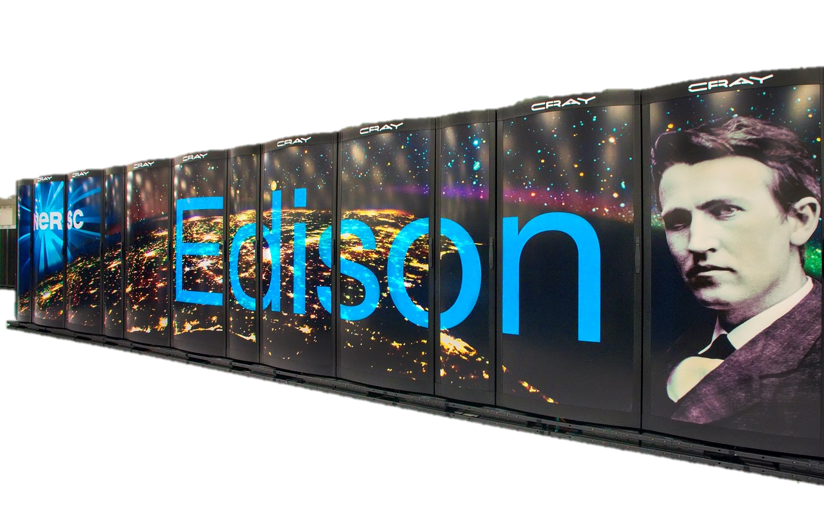
High Performance Computing (HPC)
(= Supercomputers)
National Energy Research Scientific Computing Center
(NERSC)
133,824 CPU cores
357 TB memory
5000 users
Notes:
high-performance computing, or in short, HPC.
Okay, let me do a quick survey over here. How many of you have heard of HPC? Please raise your hand. What if I tell you HPC is also called supercomputers? Okay, we get a few more. But how many of you have used supercomputers before? Alright, only some of us. That is really common because HPC is a very specific type of computing system, and it is usually not available to general people. However, it has been an important tool for computational scientists for decades. These scientists largely rely on the tremendous computational power of these machines to work for their science. To show you how powerful HPC machines are. Let’s take NERSC as an example. NERSC, which stands for the National Energy Research Scientific Computing Center, is one of the largest supercomputer centers in the United States, founded by the Department of Energy in the 1970s. One of the current HPC systems in NERSC, Edison, contains more than a hundred thousand cores, 357TB memory, and is used by 5000 scientists.

Slide 3
Impact of the NERSC HPC systems
10 years of simulation data
generated in a year
1990
15 years of simulation data
generated in a day
2015
Notes:
If those numbers do not give you a strong feeling of how powerful those systems are, let me give you a further example. One scientist told us that, in the 1990s, it took him a year to generate 10 years of simulation data from his models, but in 2015, it only took him a day to generate 15 years of simulation data. So you can see how significant those HPC systems are to scientists, and actually every year there over 1,500 journal publications produced from the projects that use NERSC machines, about 10 of these publications become journal cover stories. Until 2015, four Nobel Prizes winners have accomplished their work with NERSC machines. These all show that HPC systems are still indispensable to scientists, even though there are increasing competitions from cloud-based and other approaches to computing. What is really exciting here is that the HPC community is currently designing an even more powerful new generation machine, which is so called “exascale system”, and it is expected to come out in 2025 to foster more scientific discoveries.
An exascale machine can compute 10^18 floating point operations per second

Slide 4

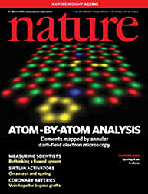

Impact of the NERSC HPC systems
10 years of simulation data
generated in a year
1500
1990
journal publications
per year
10
15 years of simulation data
generated in a day
top journal cover stories per year
2015
4
Nobel Prizes
Notes:
If those numbers do not give you a strong feeling of how powerful those systems are, let me give you a further example. One scientist told us that, in the 1990s, it took him a year to generate 10 years of simulation data from his models, but in 2015, it only took him a day to generate 15 years of simulation data. So you can see how significant those HPC systems are to scientists, and actually every year there over 1,500 journal publications produced from the projects that use NERSC machines, about 10 of these publications become journal cover stories. Until 2015, four Nobel Prizes winners have accomplished their work with NERSC machines. These all show that HPC systems are still indispensable to scientists, even though there are increasing competitions from cloud-based and other approaches to computing. What is really exciting here is that the HPC community is currently designing an even more powerful new generation machine, which is so called “exascale system”, and it is expected to come out in 2025 to foster more scientific discoveries.
An exascale machine can compute 10^18 floating point operations per second

Slide 5
Impact of the NERSC HPC systems
10 years of simulation data
generated in a year
1990
15 years of simulation data
generated in a day
2015
2025
“Exascale machines” will be coming out
Notes:
If those numbers do not give you a strong feeling of how powerful those systems are, let me give you a further example. One scientist told us that, in the 1990s, it took him a year to generate 10 years of simulation data from his models, but in 2015, it only took him a day to generate 15 years of simulation data. So you can see how significant those HPC systems are to scientists, and actually every year there over 1,500 journal publications produced from the projects that use NERSC machines, about 10 of these publications become journal cover stories. Until 2015, four Nobel Prizes winners have accomplished their work with NERSC machines. These all show that HPC systems are still indispensable to scientists, even though there are increasing competitions from cloud-based and other approaches to computing. What is really exciting here is that the HPC community is currently designing an even more powerful new generation machine, which is so called “exascale system”, and it is expected to come out in 2025 to foster more scientific discoveries.
An exascale machine can compute 10^18 floating point operations per second

Slide 6

Increased speed, increased efficiency?
Breakdowns
Misunderstandings
HPC machines
Users
Speed
Inefficiency
Complexity
Difficulties
Notes:
Nevertheless, even though advances in HPC hardware are leading to increased speed of the system, we cannot ignore that the complexity of the system are also growing. With increased complexity, users may have more breakdowns and misunderstandings of the system, which are leading to inefficiencies and difficulties. The designers of the exascale machines also begin to realize that it is no longer possible to ignore users in making design decisions. In fact, one must consider not just individual interactions between a single scientist and the machine they use, but the social interactions among people as they jointly utilize this large and expensive shared system. This leads to our key research: How can we better consider user-related aspects in HPC design?

Slide 7
Increased speed, increased efficiency?
How can we
better consider
user-related aspects in HPC design?
Breakdowns
Misunderstandings
HPC machines
Users
Speed
Inefficiency
Complexity
Difficulties
Notes:
Nevertheless, even though advances in HPC hardware are leading to increased speed of the system, we cannot ignore that the complexity of the system are also growing. With increased complexity, users may have more breakdowns and misunderstandings of the system, which are leading to inefficiencies and difficulties. The designers of the exascale machines also begin to realize that it is no longer possible to ignore users in making design decisions. In fact, one must consider not just individual interactions between a single scientist and the machine they use, but the social interactions among people as they jointly utilize this large and expensive shared system. This leads to our key research: How can we better consider user-related aspects in HPC design?

Slide 8

Time as a lens
By focusing on the temporal aspects, it “makes us speak in a different language, ask different questions, and use a different framework in the methodological aspects of our research.” (Ancona et al., 2001)
Clock time
CPU time
Floating point
operations per
second (flops)
?
Time in current HPC design
HPC machines
Users
Notes:
To address our research question, we leverage time as a lens to look at the HPC ecosystem. Using time as a lens is a method suggested by Ancona et al. They indicated that, by focusing on the temporal aspects it “makes us speak in a different language, ask different questions, and use a different framework in the methodological aspects of our research.” This approach is especially suitable to our case because if we look at time in the current HPC design, we will find that time is mostly considered in machine-related aspects, like clock time, CPU time, or floating point operations per second. Not much emphasis has been put onto user-related aspects. What’s more, there are lots of nuances on the human side that cannot be described by those mechanistic machine time metrics.

Slide 9





An exemplar HPC workflow
N
Apply for
allocation
Prepare
jobs
Submit to
queues
Jobs are
running
Archive
outputs
Notes:
Let me explain this point more with an exemplar HPC workflow on NERSC. Assuming I am a scientist who uses NERSC machines, here is what I usually do

Slide 10
An exemplar HPC workflow
N
Apply for
allocation
Prepare
jobs
Submit to
queues
Jobs are
running
Archive
outputs
Notes:
Every year I have to write a proposal with the teammates of my project to apply for CPU time allocation

Slide 11
An exemplar HPC workflow
N
Apply for
allocation
Prepare
jobs
Submit to
queues
Jobs are
running
Archive
outputs
Notes:
With the allocation we get, I can use them to run my codes on NERSC machines. To utilize HPC, I have to make my codes run in parallel and configure a job correspondingly, which usually take me some time to set up.

Slide 12
An exemplar HPC workflow
N
Apply for
allocation
Prepare
jobs
Submit to
queues
Jobs are
running
Archive
outputs
Notes:
After I finish setup, I will submit the job into the queues of the NERSC machine. Because many other scientists also use NERSC machines, it takes some time for my job to start. If the system is not busy and my job is small, I may only need to wait for a few minutes. If my job is big, I may need to wait for a week.

Slide 13
An exemplar HPC workflow
N
Apply for
allocation
Prepare
jobs
Submit to
queues
Jobs are
running
Archive
outputs
Notes:
Then when it is finally my job’s turn to run, the NERSC machines will allocate the resources I request in my job setup and start to run my job.

Slide 14
An exemplar HPC workflow
N
Apply for
allocation
Prepare
jobs
Submit to
queues
Jobs are
running
Archive
outputs
Notes:
If my job finishes successfully, I can then log onto the NERSC system and archive the outputs, which may take a while, but I have to do it anyway because there is a space limit on NERSC machines.

Slide 15
An exemplar HPC workflow
N
Apply for
allocation
Prepare
jobs
Submit to
queues
Jobs are
running
Archive
outputs
Notes:
You can see that across this exemplar workflow, there are lots of things I care cannot be described by machine time.

Slide 16
An exemplar HPC workflow
N
Apply for
allocation
Prepare
jobs
Submit to
queues
Jobs are
running
Archive
outputs
How many
CPU hours does NERSC have in total?
How many hours do I have to work on this project?
HPC machines
Users
Notes:
For example, when applying for allocation, what NERSC cares about is how many CPU hours they have, but what I care about is how many human hours I have to work on my project.

Slide 17
An exemplar HPC workflow
N
Apply for
allocation
Prepare
jobs
Submit to
queues
Jobs are
running
Archive
outputs
How to schedule jobs to best utilize the system?
How can I get my work done faster?
HPC machines
Users
Notes:
Similarly, when I submit jobs to the queues, I don’t care if the system is getting best utilized with the scheduling algorithm on NERSC. What I want is to get my work done faster. Thus, depends on the situation, I may want to set up another job before my previous one finishes, or I may want to just leave it there to work on other stuffs. All these points I have mentioned in the past minute is not something that can be covered by mechanistic metrics like floating points operations per second.

Slide 18
Time is not just a mechanistic metric
"sets of practices, which are bound up with time-reckoning and time-keeping technologies, but which vary and are shaped by different times, places and communities“ (Glennie and Thrift, 2009)
distributed collective practices not only have rhythms, but in some fundamental sense are rhythms.” (Jackson et al. 2011)
Time in CSCW literature
Notes:
This is actually echoing what a long body of research in CSCW has demonstrated: Time is not just a mechanistic metric. Like Glennie and Thrift suggested that time is “sets of practices, which are bound up with time-reckoning and time-keeping technologies, but which vary and are shaped by different times, places and communities.” In the context of collaboration, Jackson et al. also described that “distributed collective practices not only have rhythms, but in some fundamental sense are rhythms.” Our research thus focuses on the consideration of human time, machine time, and its various and entangled permutations in the social context within the HPC ecosystem. Our hope is that by considering the temporal ecosystem of users of HPC machines, we will be able to improve design decisions for the next-generation machines.

Slide 19


Methodology
Six month field study at a research center
where scientists use NERSC machines
26 interviews with 15 people
+ occasional direct observation / shadowing
13 male and 2 female. 4 domain scientists,
7 computer engineers, 4 HPC facility staff.
5~25 years experiences with HPC
Notes:
Now, let me tell you about the methodology of our work. We conducted a 6 month field study at a research center where scientists use NERSC machines, and we did 26 interviews with 15 people in total, along with occasional direct observation and shadowing. Among the 15 people, we have 13 male and 2 female interviewees, and 4 of them are domain scientists, 7 of them are computer engineers, and the rest of them are HPC facility staff members. Their experiences with HPC range from 5 to 25 years.

Slide 20
Finding 1:
Time cost in preparing jobs
I am not really interested in making a script that takes an hour, run in 10 minutes. I am interested in taking a script that runs three days, and running in one, or less … Where my interests are, is making the intractable problem, tractable; not making the tractable problems faster, because they’re tractable, who cares?
[Domain Scientist A]
  Getting codes to run really fast on HPC takes time to learn and to do, and it is not what scientists are interested in
Notes:
We have a set of findings from the field study, and you can find more details in our paper. For today, I would like to highlight four points. The first one is related to the time cost in preparing jobs. Let’s look at this quote first: “I am not really interested in making a script that takes an hour, run in 10 minutes. I am interested in taking a script that runs three days, and running in one, or less … Where my interests are, is making the intractable problem, tractable; not making the tractable problems faster, because they’re tractable, who cares?” This quote basically shows that setting codes to run really fast on HPC takes time to learn and to do, and it is not what scientists are interested in.

Slide 21
Finding 2:
Variability and uncertainty in execution
  You don't always get the same result when you do something twice… Sometimes I will run something literally without changing anything, resubmit the same job again. It will have failed once. It will run successfully the second time. [Domain Scientist C]
  Variability and uncertainty in the system: It can take people a long time to debug long run-times or failures.
Notes:
The second point is regarding the variability and uncertainty in the execution stage. One participant told us: “You don't always get the same result when you do something twice… Sometimes I will run something literally without changing anything, resubmit the same job again. It will have failed once. It will run successfully the second time.” Since the system is shared, one’s job may be influenced by other people’s jobs. Sometimes this may lead to issues and failures in running a job, which can take people a long time to debug.

Slide 22
Finding 3:
Time to handle system upgrades
Every time there's an operating system upgrade, it hurts us badly. We haven't gone through any of them without some kind of scar. Sometimes it's really bad. This one is really bad. It may be weeks or months before we actually can run again. [Domain Scientist A]
  System upgrades enhance performance, but they can lead to compatibility issues which take scientists a long time to fix
Notes:
Finally, I want to point out a special issue they encountered during our field study: system upgrades. The HPC machines periodically get upgraded, and here is a comment a domain scientist made: “Every time there's an operating system upgrade, it hurts us badly. We haven't gone through any of them without some kind of scar. Sometimes it's really bad. This one is really bad. It may be weeks or months before we actually can run again.” Although from the facility staff’s point of view, system upgrade is to enhance performance, the compatibility issues make take scientists a long time to fix. I have to make a special point that, even though sometimes we also experience difficulties after upgrade the OS of our laptops, what scientists face with HPC upgrades is a totally different experience. Because HPC machines may be one-of-a-kind, there is no online forum for scientists to seek for solutions. Also, many hand-coded applications written by domain scientists are not well-tested commercial tools. As HPC is a large and complex system, the scale of the problem is way more complicated than the issues we face in general purpose laptops.

Slide 23
Theme 1:
Conflicts between temporal rhythms
  Temporal rhythm conflicts in collaboration (Jackson et al. 2011)
  Run fast
  Code fast
  Upgrade system for performance
  Handle issues
  caused by upgrades
  Identifying temporal rhythms and their conflicts in the HPC ecosystem
Notes:
Drawing from our findings, we identified five common themes that we see as being useful when considering the next generation HPC design. Let me highlight three of them and please read our paper for more details. The first theme we found is related to the conflicts between temporal rhythms. This is similar to the idea of Jackson et al.’s findings in the collaboration context. For instance, making software run faster requires a huge amount of human time to code; Asking for help may solve the problem faster but the time to communicate is a trade-off. Upgrading the OS can enhance performance but it may require extra time to handle issues. These kinds of temporal rhythm are pervasive in the HPC ecosystem and we think it is critical to identify them and the conflicts between them.

Slide 24

Theme 2:
Challenges in communication
Users
Users
HPC machines
Users
  Surfacing states and intentions are critical
  (Ackerman 2000, Aragon et al. 2008, Bardram 2000, Begole 2002, Dourish & Button 1998, Kusunoki & Sarcevic 2015, Landgren 2006, Mazmanian & Erickson 2014, Mazmanian, Erickson & Harmon 2015)
Notes:
The second theme is regarding challenges in communication. This includes communication between users and those between machines and humans. For communication between users, one example is again the time cost to ask for help from another person. As for the communicate between users and machines: remember that we talked about the issue that users spent a whole bunch of time trying to debug their codes, but it turned out that the job failed merely due to the uncertainty of the system. This is a good example to illustrate that the system did not communicate well to user where the failures came from. As previous literature suggests that surfacing states and intentions is critical, we think more work should be done on better supporting that in communication.

Slide 25

Theme 3:
Collective Time
  Technology can shape the ways time is organized
  (Ackerman 2000, Lindley 2015, Orlikowski & Yates 2002 )
Users
HPC machines
. . .
Temporal
rhythms
?
Notes:
The last theme I want to talk about today is collective time. By collective time we mean we should consider all time-related aspects, including human time and machine time, and all kinds of temporal rhythms, and not only mechanistic time. As previous work has suggested, technology can shape the ways time is organized, we suggest that providing ways to surface temporal rhythms in HPC ecosystem may help people work and think about time in a more collective way. And we think that further attention to this problem is important, and that certain types of collective visualization interfaces for scheduling may be helpful.

Slide 26
Final take away
  It is critical to consider user-related aspects in designing large-scale systems for scientific computing
  Using time as a lens helps us to identify important design spaces in this large-scale sociotechnical ecosystem
  Open questions for designers…
    What can be designed to help resolve temporal rhythm conflicts?
    How to better communicate states and intentions in the ecosystem?
    Which designs can support and shape people’s understanding of time and temporal rhythm in the ecosystem in a collective way?
Notes:
As the final take away, I want to reemphasize that, it is important to consider user-related aspects in designing large-scale systems for scientific computing. Using time as a lens helps us to identify important design spaces in this large-scale ecosystem. In this work, we left a few open questions for designers to further work on: What can be designed to help resolve temporal rhythm conflicts? How to better communicate states and intentions in the ecosystem? Which designs can support and shape people’s understanding of time and temporal rhythm in the ecosystem in a collective way? Although our work mainly focuses on HPC, we believe the questions and issues found can be valuable to any type of large-scale ecosystem, and we invite all of you to further study these questions with us.

Slide 27
Acknowledgments
  This work was funded by the Office of Science, Office of Advanced Scientific Computing Research (ASCR) of the U.S. Department of Energy under Contract Number DE-AC02-05CH11231 and award number DE-SC0012474.
  All the participants
Notes:
Finally, I want to acknowledge our funding agency and all the participants of our study.

Slide 28

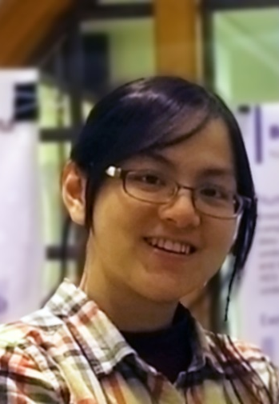
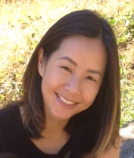
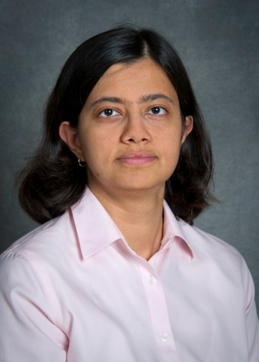




  UDA - Usable Data Abstractions Project Blog
  http://uda.lbl.gov
  Nan-Chen Chen
Sarah S. Poon
Lavanya Ramakrishnan
Cecilia R. Aragon
  More questions/comments?
  nanchen@uw.edu
UTC+8
Taipei Time
Notes:
If you are interested in knowing more about our work, please check out our blog or email me if you have any questions. I should be right in time now for Q&A so I would like to take some questions now. Thank you!

