Slide 1

101北一女中
資訊選手培訓營
圖論基礎
2012.07.08 Nan

Slide 2

圖論，到底是什麼呢？

Slide 3



Slide 4


Slide 5
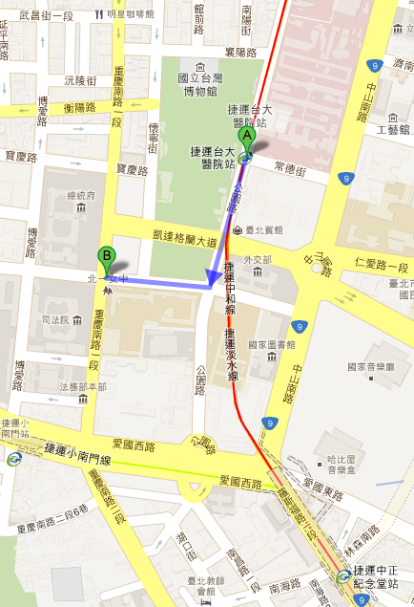

Slide 6


Slide 7
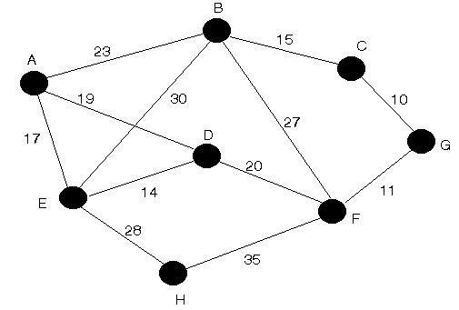
圖論最常出現的形式：
點(Vertex
or Node)
邊(Edge)
<無向邊vs. 有向邊>
兩種在程式裡表示的方式：
鄰接矩陣跟鄰接串列
權重(Weight)

Slide 8
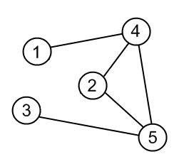
鄰接矩陣
map | [0] | [1] | [2] | [3] | [4]
[0] | 0 | 0 | 1 | 1 | 1
[1] | 0 | 0 | 0 | 0 | 1
[2] | 1 | 0 | 0 | 0 | 1
[3] | 1 | 0 | 0 | 0 | 0
[4] | 1 | 1 | 1 | 0 | 0
0
無權重無向邊
int map[5][5] =
{ {0, 0, 1, 1, 1},
{0, 0, 0, 0, 1},
{1, 0, 0, 0, 1},
{1, 0, 0, 0, 0},
{1, 1, 1, 0, 0} };

Slide 9
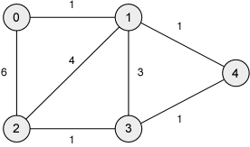
鄰接矩陣
map | [0] | [1] | [2] | [3] | [4]
[0] | 0 | 1 | 6 | INF | INF
[1] | 1 | 0 | 4 | 3 | 1
[2] | 6 | 4 | 0 | 1 | INF
[3] | INF | 3 | 1 | 0 | 1
[4] | INF | 1 | INF | 1 | 0
有權重無向邊
#define INF 2147483647
int map[5][5] =
{ {0, 1, 6, INF, INF},
{1, 0, 4, 3, 1},
{6, 4, 0, 1, INF},
{INF, 3, 1, 0, 1},
{INF, 1, INF, 1, 0} };

Slide 10
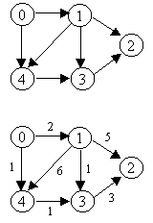
鄰接矩陣
無權重有向邊
map | [0] | [1] | [2] | [3] | [4]
[0] | 0 | 1 | 0 | 0 | 1
[1] | 0 | 0 | 1 | 1 | 1
[2] | 0 | 0 | 0 | 0 | 0
[3] | 0 | 0 | 1 | 0 | 0
[4] | 0 | 0 | 0 | 1 | 0
有權重有向邊
map | [0] | [1] | [2] | [3] | [4]
[0] | 0 | 2 | INF | INF | 1
[1] | INF | 0 | 5 | 1 | 6
[2] | INF | INF | 0 | INF | INF
[3] | INF | INF | 3 | 0 | INF
[4] | INF | INF | INF | 1 | 0

Slide 11
鄰接串列
map
[0]
[1]
[2]
[3]
[4]
2
3
4
0
4
無權重無向邊
0
4
struct node {
int id;
struct node *next;
};
0
0
1
2
struct node * map[5];

Slide 12
鄰接串列
map
[0]
[1]
[2]
[3]
[4]
1/1
2/6
0/1
2/4
3/3
4/1
有權重無向邊
3/1
0/6
1/4
struct edge {
  int id;
  int weight;
  struct edge *next;
};
1/3
2/1
4/1
1/1
3/1
struct edge* map[5];

Slide 13
鄰接串列
無權重有向邊
基本上跟無向的很像，
只是只會有一個方向有邊。
所以…換你畫囉~~
有權重有向邊

Slide 14
補充：串接的方式
#include <stdlib.h>
#define NEW(T, N) (T)malloc((N) * sizeof(T) )
struct edge {
  int id;
  int weight;
  struct edge *next;
};
int main(){
struct edge *map[5];
struct edge *ptr = 0;
ptr = NEW(struct edge, 1);
ptr->id = 1;
ptr->weight = 1;
ptr->next = NULL;
map[0] = ptr;
ptr = NEW(struct edge, 1);
ptr->id = 2;
ptr->weight = 6;
ptr->next = NULL;
map[0]->next = ptr;
//…
}

Slide 15

你暈了嗎？
別擔心，我們目前比較常用的是鄰接矩陣的做法。
但真正在寫軟體什麼的話，是要用鄰接串列喔！

